Slide 1
NBA PLAYER POSITION PREDICTION
BY:
B MARIA MANOJE
(aspiring data analyst)

Slide 2
OBJECTIVE
The Project I have chosen is NBA PLAYER POSITION PREDICTION
Here, I do some Machine learning(supervised learning) approaches to try to predict a modern NBA player's position for a given season based on their statistics

Slide 3
FLOW CHAT
DATA IMPORT
EDA
DATA MODELING
i) data splitting
ii)Clustering
classifier predicting
DATA PREDICTION

Slide 4
BACKGROUND
Imported necessary Libraries for the Program and get the necessary data
Dropped the “Rank”and “Playername”data columns from the Dataset.
Then Done Train and Test Split and 10 Machine learning Algorithms.

Slide 5
POSITIONS
SMALL FORWARD(SF)
SHOOTING GUARD(SG)
POWER FORWARD(PF)
POINT GUARD(PG)
CENTER

Slide 6
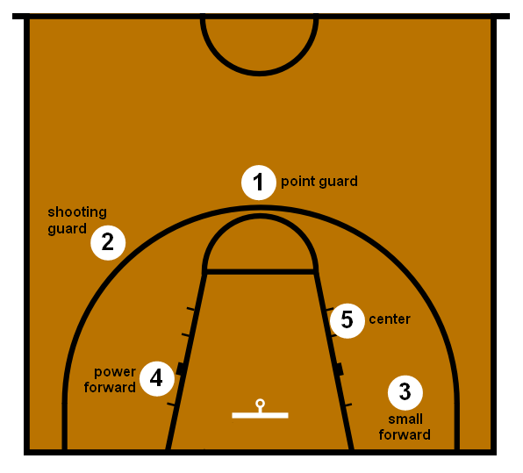
POSITION LAYOUT

Slide 7
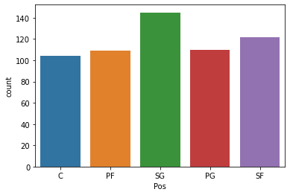
NO OF POSITION’S

Slide 8
WHAT I DID ?
The Algorithms(LogisticRegression, DecisionTreeClassifier, RandomForestClassifier ,and so on)
CODE:
https://github.com/MARIAMANOJE/player-position-prediction/blob/main/player%20position%20prediction.ipynb

Slide 9
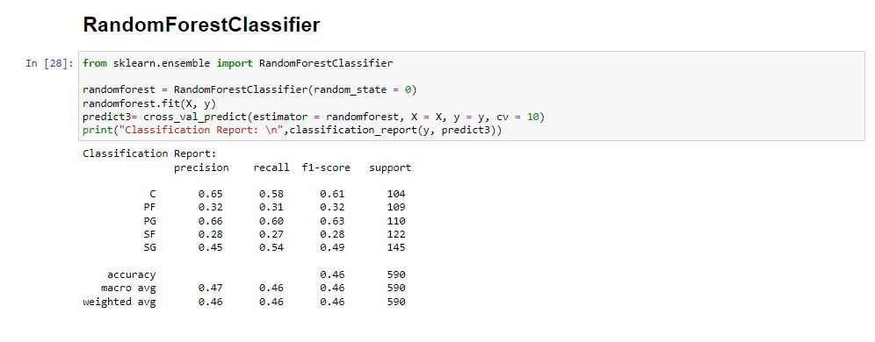
BEST MODEL

Slide 10
CONCLUSION
From 10 Machine learning Algorithms DecisionTreeClassifier best accuracy when compared to other 9 algorithms.
I have taken DecisionTreeClassifierfor NBA PLAYER POSITION PREDICTION

Slide 11

THANK YOU

